Slide 1
Tail-GNN: Tail-Node Graph Neural Networks
KDD 2021
Code: None
2021.11.14 • ChongQing
Reported by Chenghong Li

Slide 2
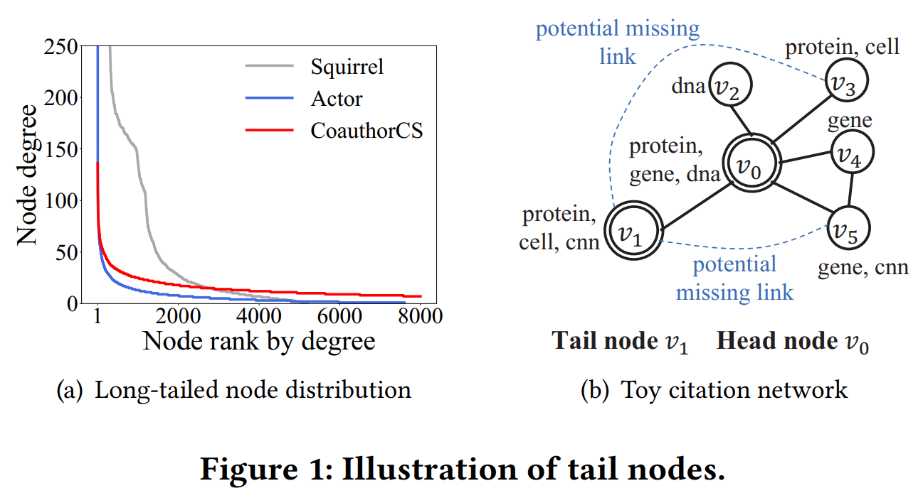
Introduction

Slide 3
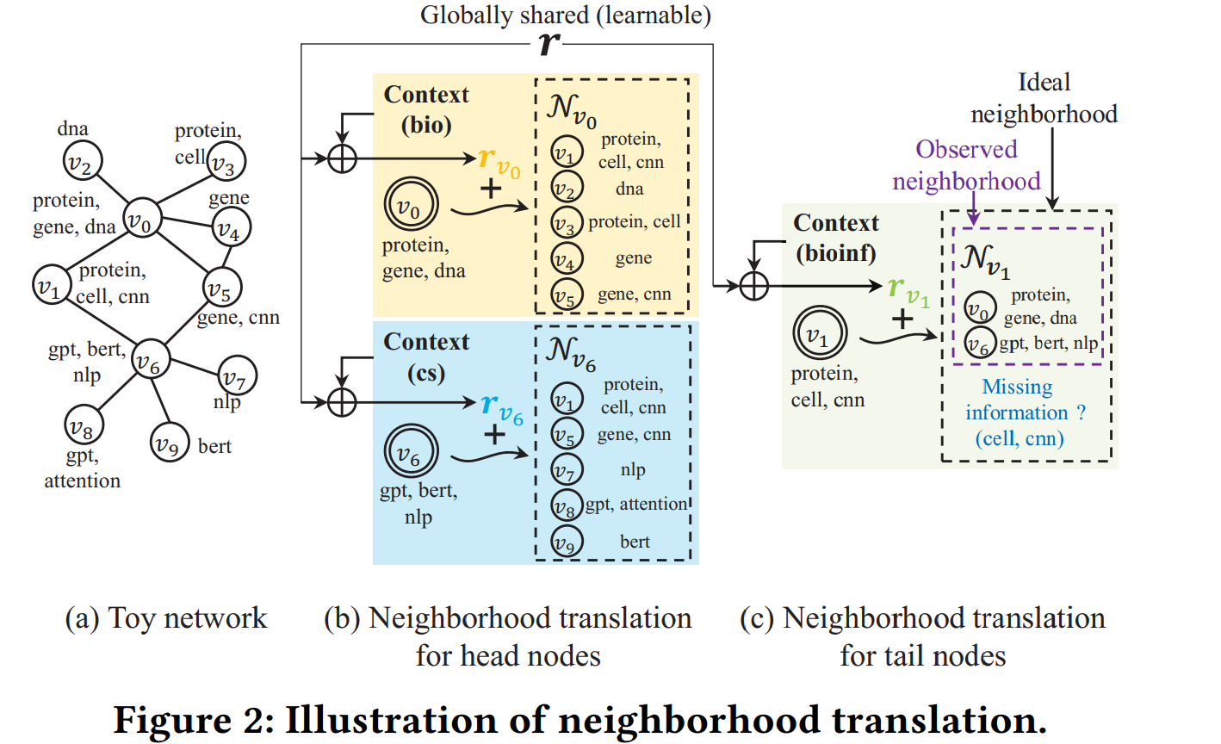
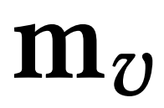
Method

Slide 4
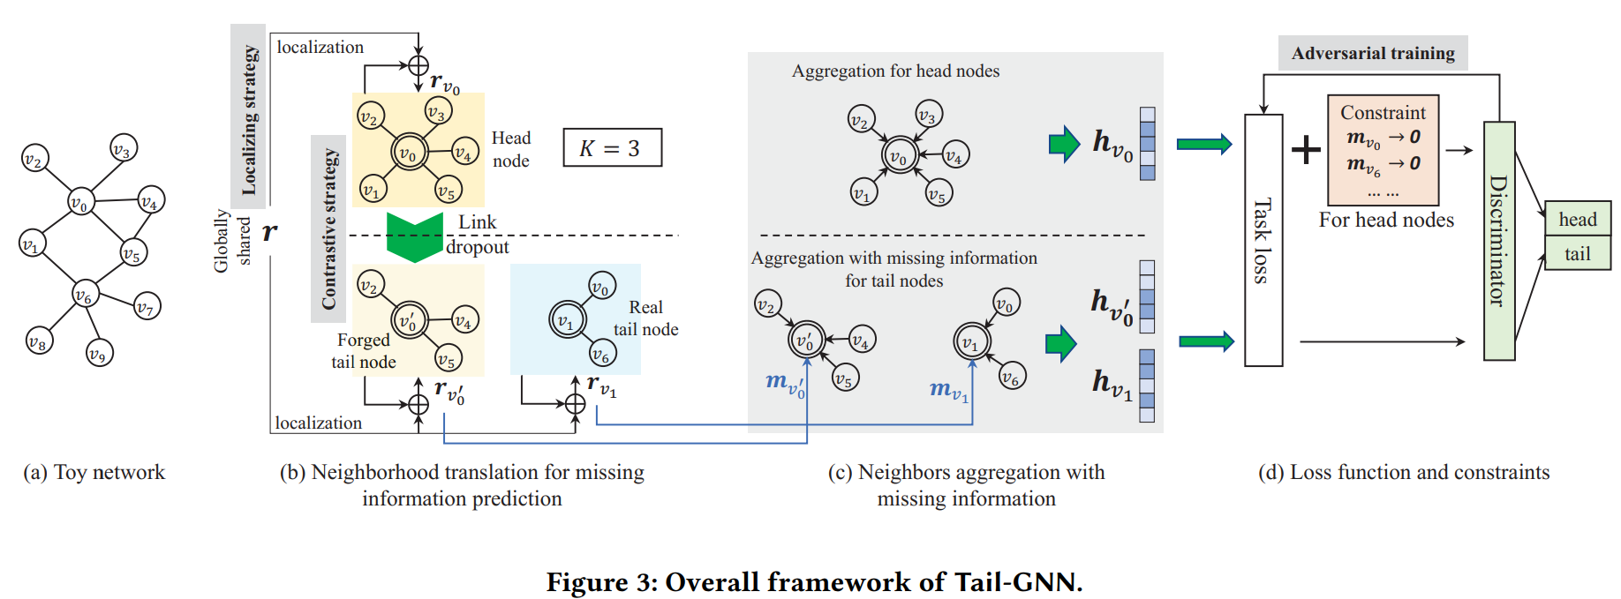
Method

Slide 5
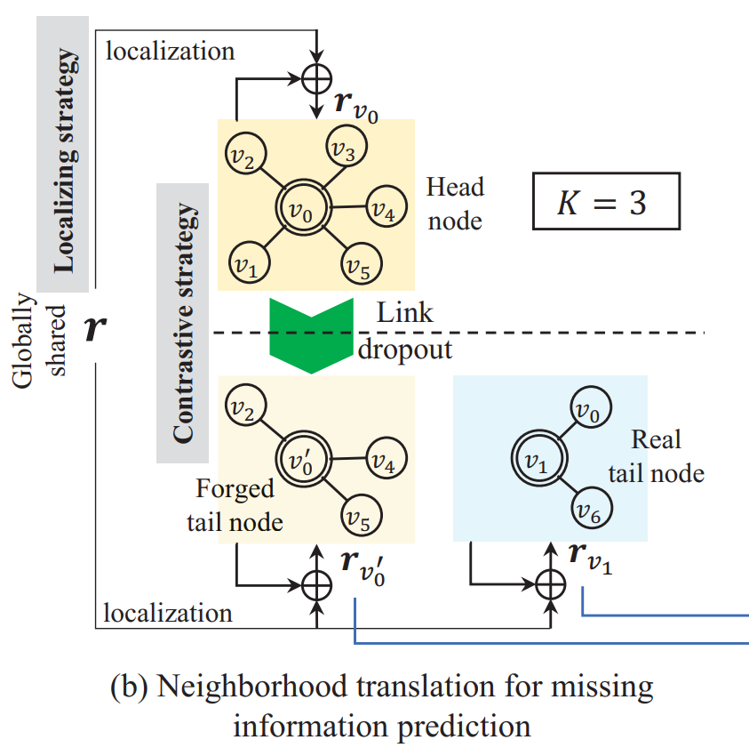
Method

Slide 6
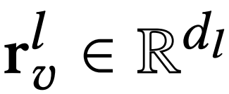
Method

Slide 7
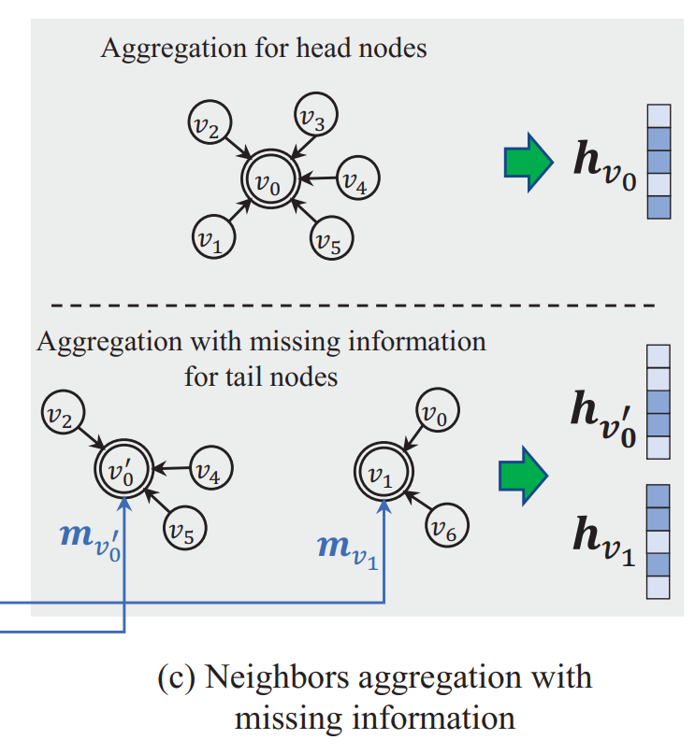
Method

Slide 8
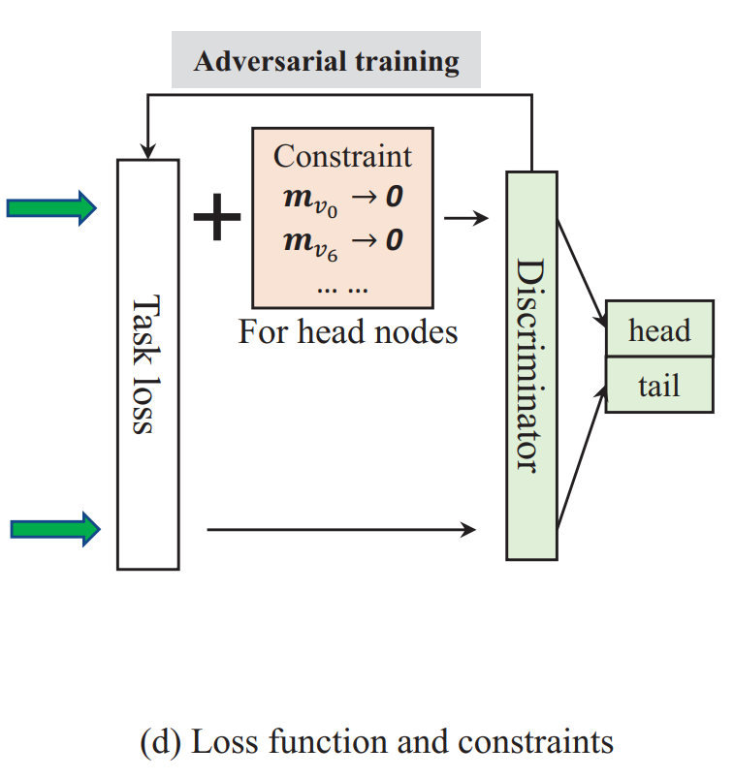
Method

Slide 9
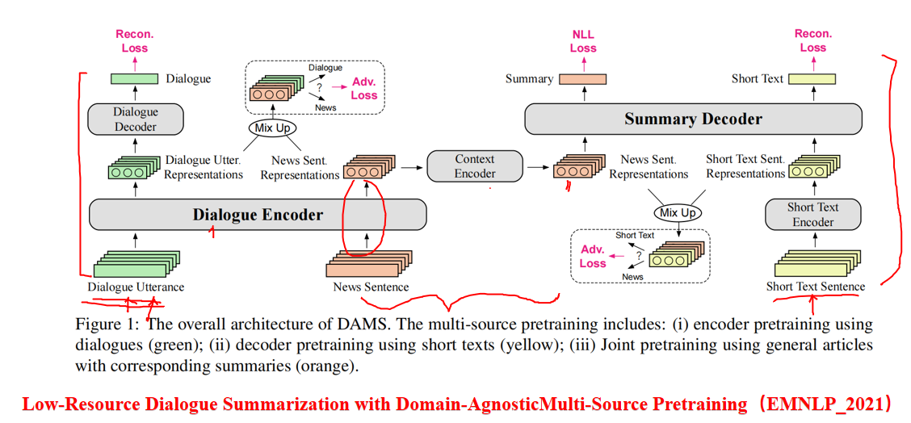
2021_ACL_Effectively Leveraging Unlabeled Data via Adversarial

Slide 10
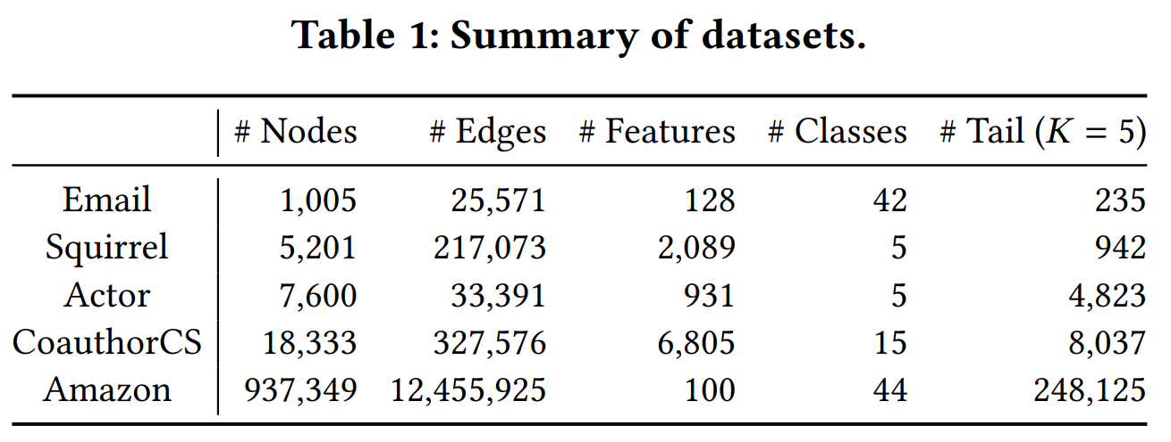
Experiments

Slide 11
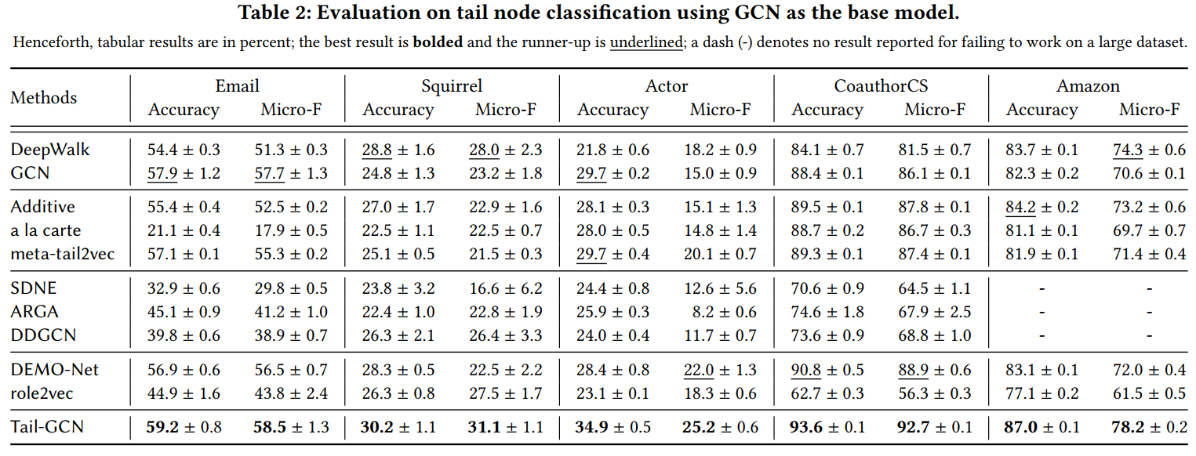
Experiments

Slide 12
Experiments

Slide 13
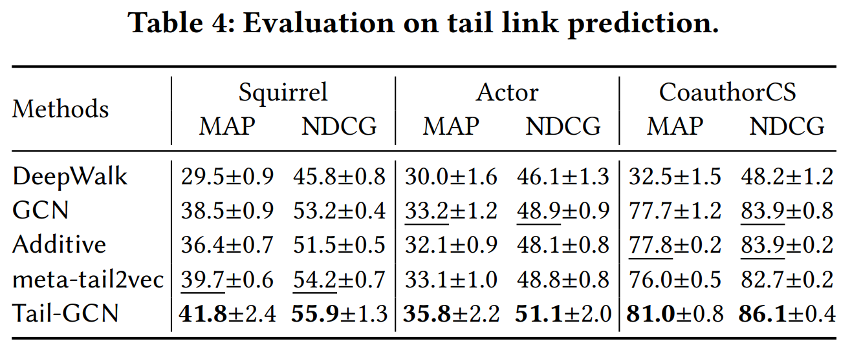
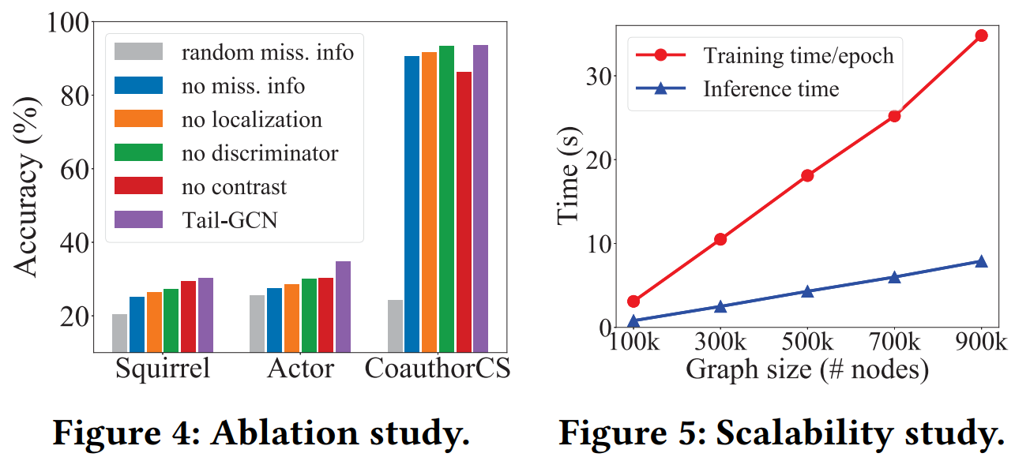
Experiments

Slide 14
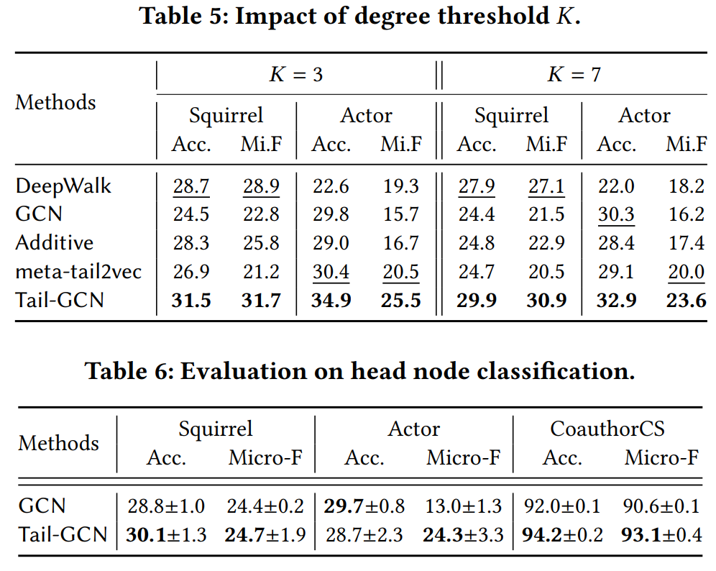
Experiments

Slide 15
Thanks

